Slide 1
Syndromic Surveillance using R
A short course: Lecture 1
These materials are adapted from a previous training and were made by Isabel Fulcher, Bethany Hedt-Gauthier, and Michael Law

Slide 2
Acknowledgements
Materials
Isabel Fulcher
Bethany Hedt-Gauthier
Michael Law
Collaborators
Anuraag Gopaluni
Bethany Hedt-Gauthier
Emma Boley
Luke Krangar
Patrick Konwloh
Prince Varney

Slide 3
Expectations
Questions:
Raise hand.
Ask at any time!
Breaks
Structured breaks ~1/hour
Take whatever breaks you need

Slide 4
Daily Structure (roughly)
Today:
11-12AM: Lecture
1-3pm: Lab
3-4pm: Lecture
Tuesday – Friday:
9 AM – 1015AM – Lecture
1030AM – 12PM – Lab/Project
1pm – 2pm – Lecture
215pm – 4pm – Lab/Project
4pm – 5pm – (Optional) Office hours/extra help
* Friday end at 1pm

Slide 5
In this lecture
My background
Goals of this training
Motivating example – syndromic surveillance
Intro to R

Slide 6
Background and Overview

Slide 7
My background
MA in applied math
Taught high school math for 2 years.
Completing PhD in Biostatistics
Coding in R!
(outside of work): Enjoy cooking, making music, and spending time with my two cats and fiancé.

Slide 8
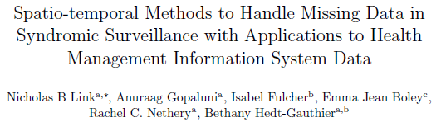
Syndromic Surveillance Work
Ran a simulation study on syndromic surveillance on HMIS data using spatio-temporal models and with missing data.
Collaborating with HIS team about syndromic surveillance and this training.

Slide 9
Breakout Question
Why are you attending this training?
What are you hoping to learn?
What background skills and knowledge do you bring?
Write your answer and then share with people near you

Slide 10
My Response
Why am I conducting this training?
I want to share my experience with coding and statistics.
I want to gain experience leading trainings.
I want to learn about the unique challenges this group faces and the situational understanding this team has in addressing them.
I want to support the Liberia MOH team!
What do I bring?
Enthusiasm and training in statistics and R

Slide 11
Goals of this training
Become familiar with the R programming language.
Understand syndromic surveillance and implement an outbreak detection model.
Identify relevant indicators
To describe and interpret the models used
Understand the data processing pipeline
Interpret results
Implement data cleaning, modeling and visualization process in R.

Slide 12
Goals of this course
The specific objectives are:
To identify indicators most relevant for these purposes.
To describe and interpret the models used to a) establish a baseline; b) assess higher or lower levels than expected during the pandemic.
To understand the data processing pipeline - from receipt of indicator data to production of figures.
To interpret results from the various visualizations of the data and results.
To be able to implement the data cleaning, modeling and visualization process in R.

Slide 13
Motivating Example – Syndromic Surveillance

Slide 14
Core common questions
How can we learn from the COVID-19 pandemic to address emerging diseases?
What is the burden of Lassa Fever and mPox?
How can we conduct surveillance on diseases that are hard to track?

Slide 15
How can we leverage routinely collected data to improve COVID-19 response?
Syndromic Surveillance
Health Service Utilization
What regional areas have a higher than expected increase in the number of patients with COVID-19-associated symptoms?
How do the number of individuals receiving care during the COVID-19 pandemic compare to what is expected?
The methods for routine monitoring will involve identifying “deviations” from what is expected for further investigation.
Notes:
There are TWO goals of this activity.
The first goal is to assessing the direct impact of COVID19 through syndromic surveillance. This involves using data on symptoms or outcome directly related to COVID-19 to flag geographic areas for potential COVID-19 circulation. This does not use information on positive COVID-19 tests, but instead uses information on symptoms, such as pneumonia or flu-like symptoms, to identify hotspots.
The second goal is to quantify the indirect impacts of COVID19 on utilization of essential health services, which range from assessing changes in the number of outpatient visits to the number babies delivered in a health facility to the number of children receiving their immunizations.
Despite being two distinct goals, these goals do share the fact they BOTH use routinely collected data and look for deviations from what is “expected”. And so, the data science tools that we use will be similar.

Slide 16
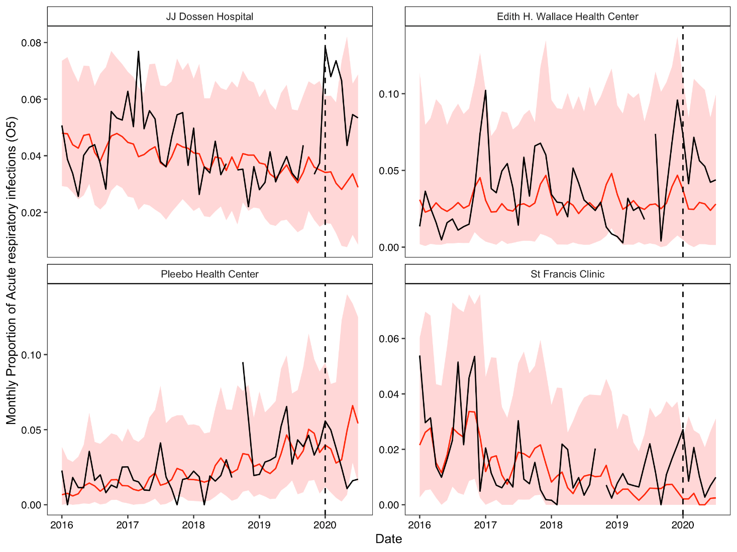
Increased in ARI cases at 3 PIH-supported facilities in Maryland County for ages ≥5 years
Higher proportions of ARI cases were also observed at JJD, Edith Wallace and St. Francis late 2019 into early 2020 at these 3 PIH-supported facilities in Maryland County for individuals 5 years or older.
Red: predicted visits based on prior data with 95% prediction intervals
Black: observed visits
Dotted line: Extrapolation period begins
Credit: Emma Boley, Izzie Fulcher

Slide 17
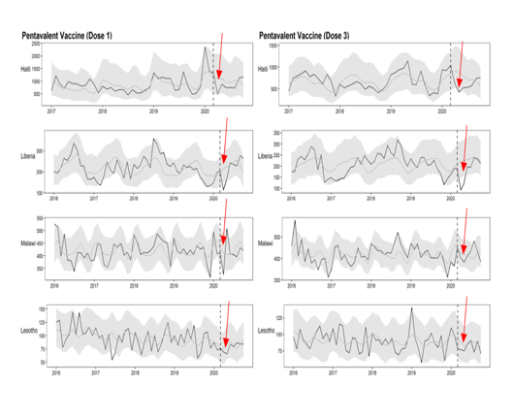
Steeper reductions observed in Pentavalent in Haiti, Liberia & Malawi early in 2020
We observed reduce pentavalent vaccination coverage for both doses (1 & 3), but reduction was not sustained!
Credit: Emilia Connolly, Emma Boley, Izzie Fulcher

Slide 18
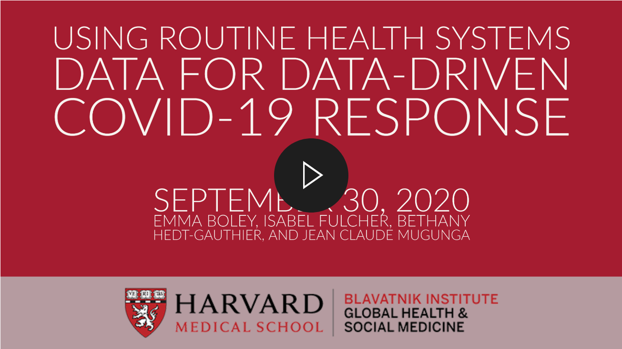
Resources

Slide 19
Selecting indicators

Slide 20
What is an indicator?
An indicator is a quantitative metric that can be used to:
Monitor uptake
Assess achievement
Provide warnings
Indicators should be well-defined and consistently measured.
For this project, we are limiting to indicators available in health management information systems (HMIS) and for many places, specifically captured in DHIS2.

Slide 21
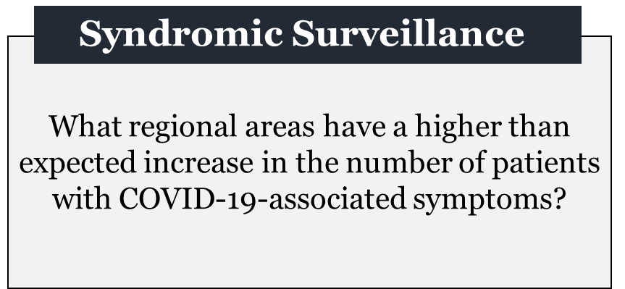
Syndromic surveillance
Monitor disease symptoms rather than the disease itself.
Not as good as monitoring the disease itself.
May give indicators of where disease is present, if it is difficult to monitor directly.

Slide 22
COVID-19 Surveillance
Ideally, we would monitor COVID-19 directly.
What indicators are countries using to look directly at COVID-19?
Why is it not always possible to use these indicators to monitor COVID-19?

Slide 23
mPox and Lassa Fever Surveillance
What indicators could we use for mPox?
For lassa fever?
What issues might arise from either of these indicators?

Slide 24
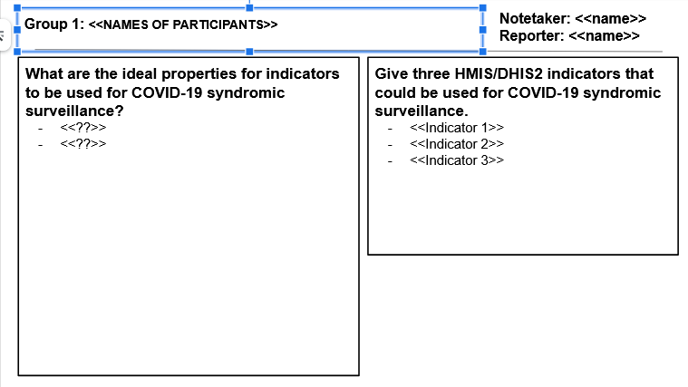
Group work
In small groups (3-4 people), discuss:
What are ideal properties for indicators to be used for syndromic surveillance?
Three indicators for COVID-19 Sruveillance.
10 minutes.
Designate a notetaker and someone to report back.
Notes:
https://docs.google.com/presentation/d/1aQ_OAYSbnvk0bWnosfPtf5EA517R3yfuZT0QgSs52eA/edit#slide=id.gc176dbddcc_0_0

Slide 25
Properties of a COVID-19 SS indicator

Slide 26
Recommended indicators

Slide 28
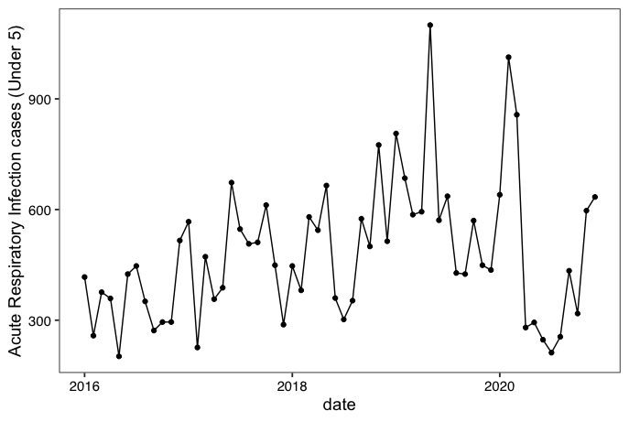
Acute Respiratory Infection cases among children (under 5) for Neno District Hospital

Slide 29
Health service utilization indicators
Assess uptake of essential health services.
Compare uptake to “expected”.
Assessment of reasons for changes.
Targeted interventions to address any deficits.

Slide 31
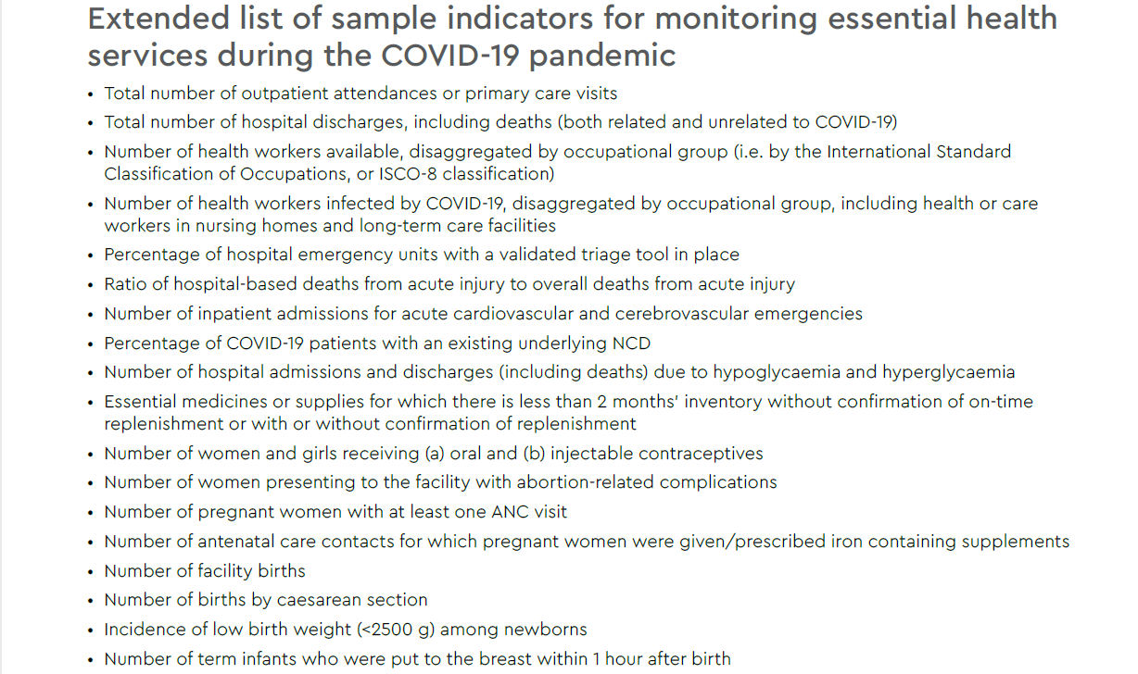
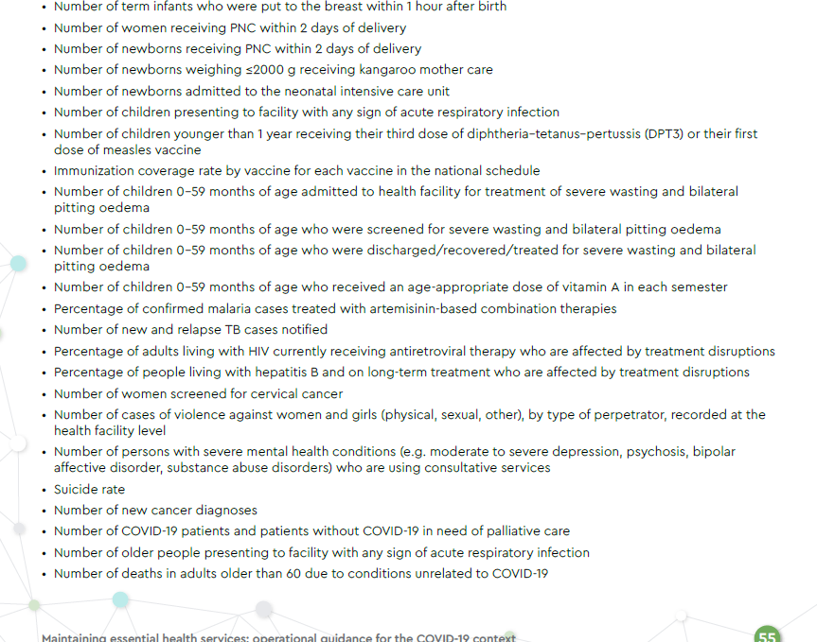

Slide 32
What about service utilization indicators?
Which of the ideal properties remain true when looking at HSU indicators?
Are there any different considerations when selecting HSU indicators?

Slide 33
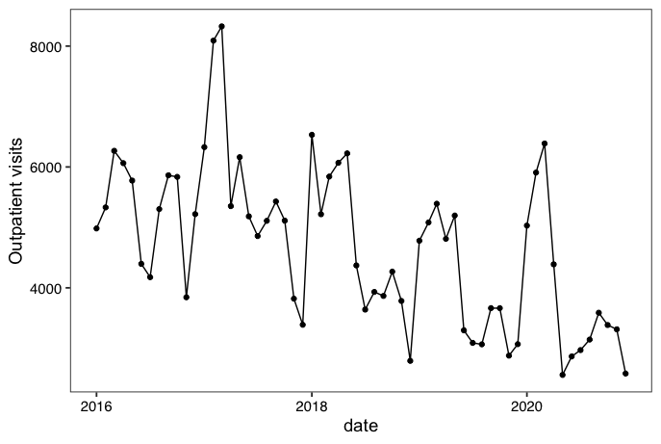
Outpatient visits for Lisungwi Health Centre

Slide 34
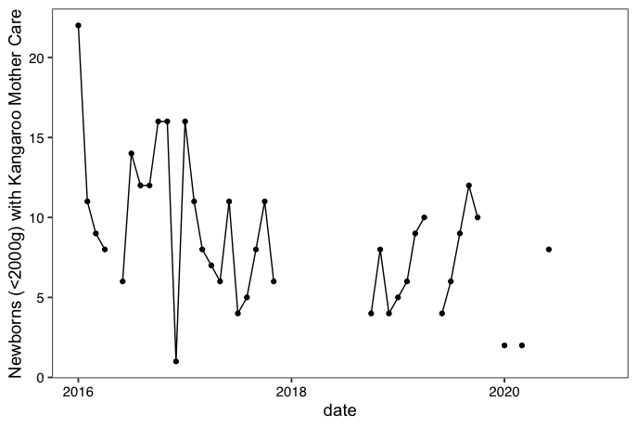
Kangaroo Mother Care indicator for Neno District Hospital

Slide 35
What’s next?
Today’s lab: Importing data and producing plots.
Week 2: Building basic time series models
Week 3: Determining expected and comparing to observed
Week 4: Data processing
Week 5: Visualizations

Slide 36
Lab

Slide 37
Why use R?
It is free!
Easy data manipulation and graphics
It has extensive packages for (almost) any specialized tool/analysis.
Easy reproducibility (R Markdown)
Computationally faster than Stata

Slide 38
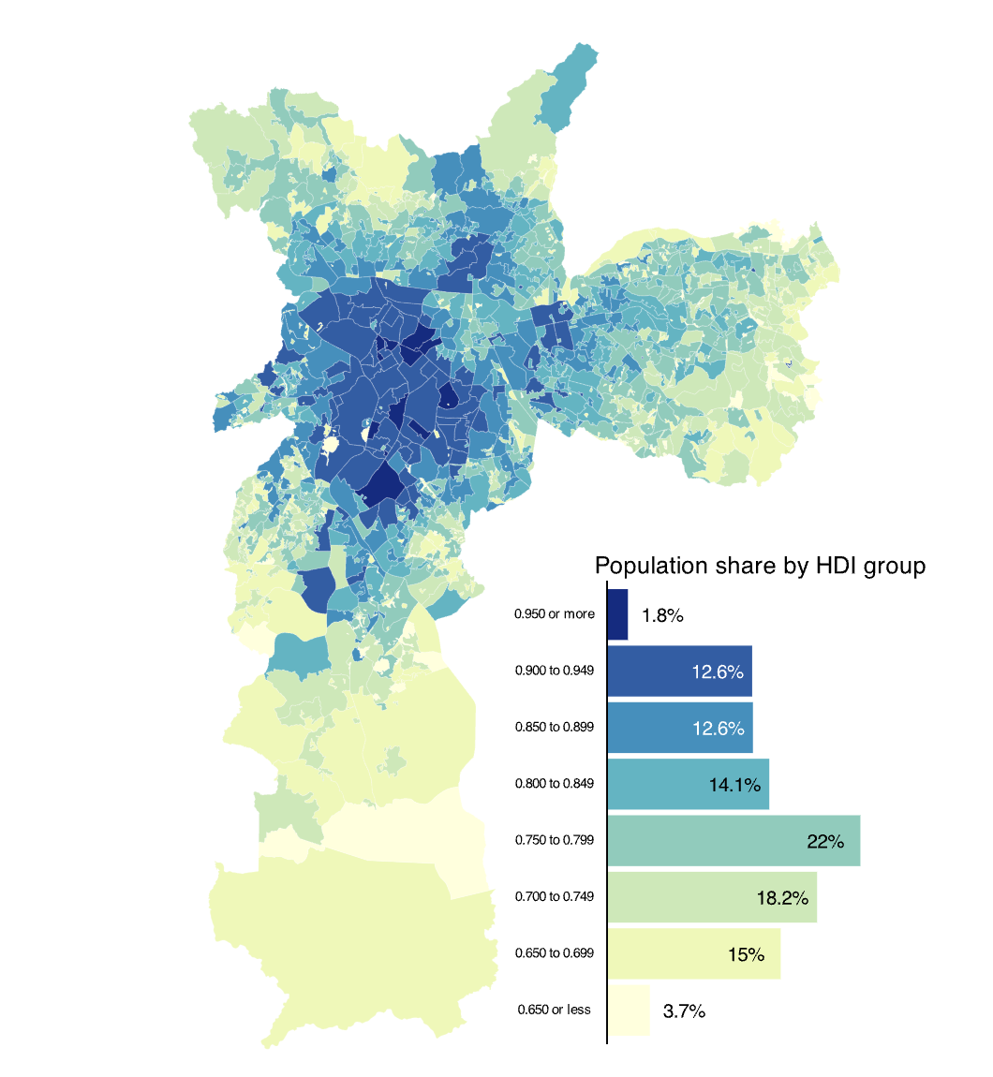
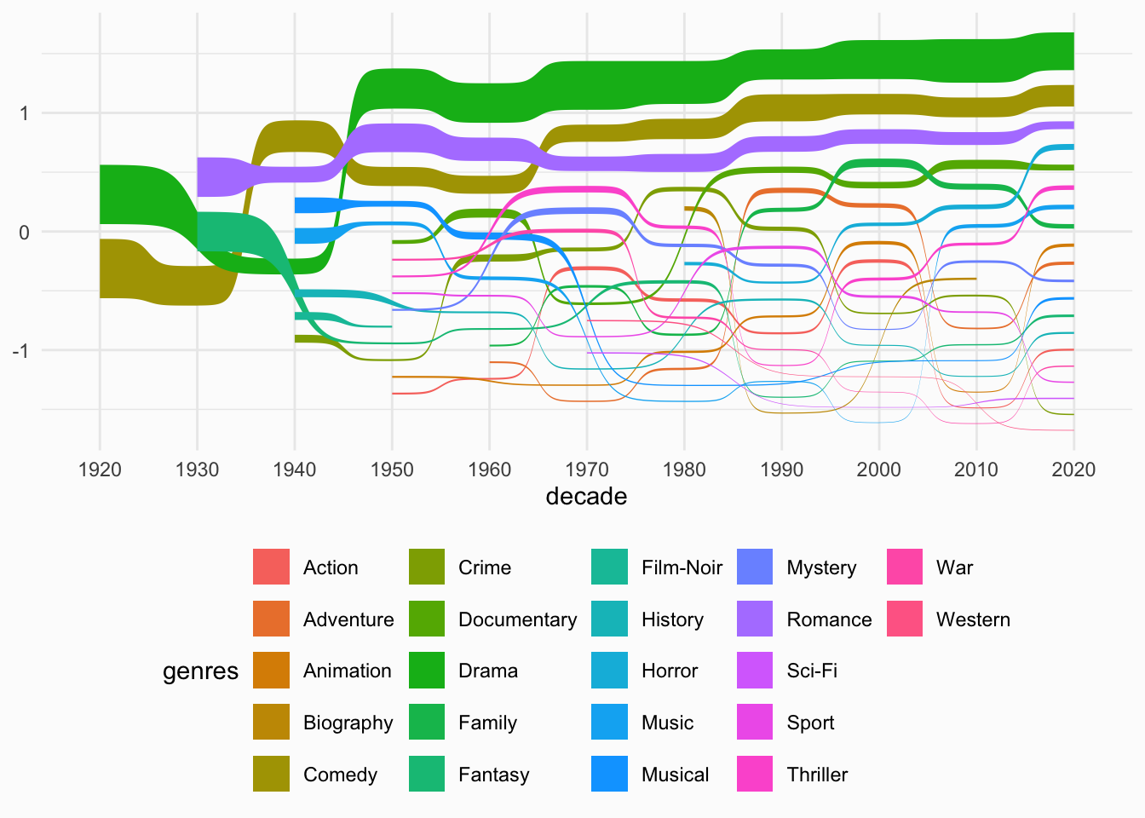
R examples
https://r-graph-gallery.com/
https://hoga.shinyapps.io/healthdown/

Slide 39
Logistics
Send an email to nicklink@g.harvard.edu with subject “Syndromic Surveillance Training”.
Course materials: https://nickblink.github.io/Syndromic_Surveillance_Training_Course/ (tinyurl: )
Install R and Rstudio

